Slide 1
CAPSTONE PROJECT: A PREDICTIVE MODELLING FOR COVID-19 IN PUBLIC HEALTH
CHESTO EMMANUEL IBRAHIM
FE/23/84581344

Slide 2
INTRODUCTION
In this project, I will analyze the COVID-19 pandemic using data on cases, deaths, and recoveries. The goal of this analysis is to understand how the pandemic spread over time in different countries and regions. Additionally, I will apply machine learning techniques to predict future outcomes, such as the increase in cases or deaths, based on historical data.

Slide 3
GOALS
Understand how COVID-19 spread over time in different countries and regions. Analyze the cumulative number of confirmed cases, deaths, and recoveries. Visualize data to identify patterns in the distribution of cases, recoveries, and deaths. Apply machine learning models to predict outcomes such as the increase in cases or deaths in the future.

Slide 4
METHODOLOGY
Data Used I will use data with the following features: Lat (Latitude): To determine geographical locations north or south. Long (Longitude): To determine geographical locations east or west. Date: The date of the daily report. Confirmed: The cumulative number of confirmed cases up to this day. Deaths: The cumulative number of deaths up to this day. Recovered: The cumulative number of recovered cases up to this day.

Slide 5
METHODOLOGY
Steps Import libraries and data. Clean and prepare the data for analysis. Explore and visualize general patterns. Train machine learning models to predict and analyze complex patterns.

Slide 6
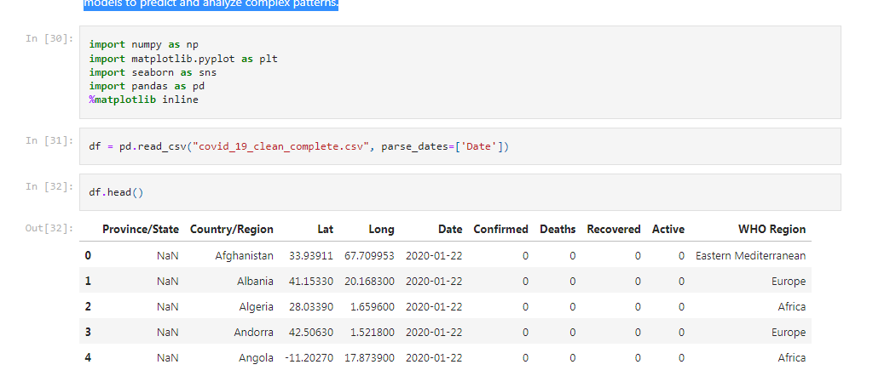

Slide 7
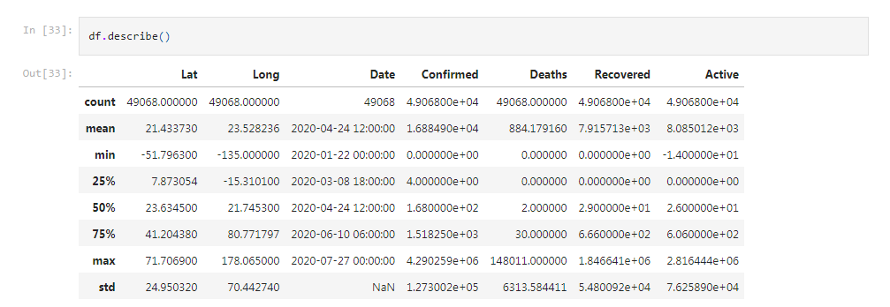

Slide 8
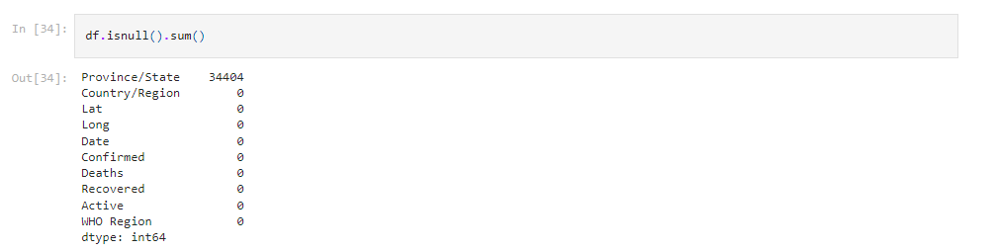

Slide 9
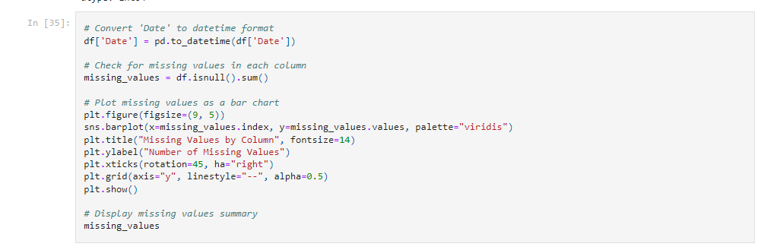

Slide 10
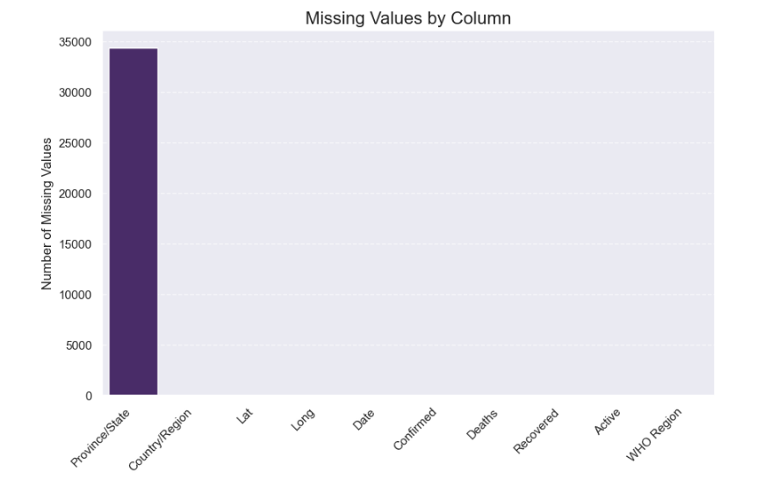

Slide 11
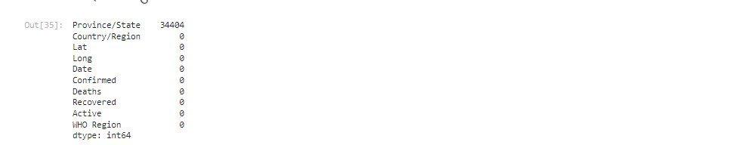

Slide 12
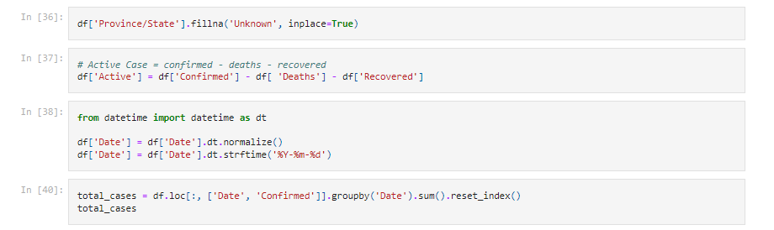

Slide 13
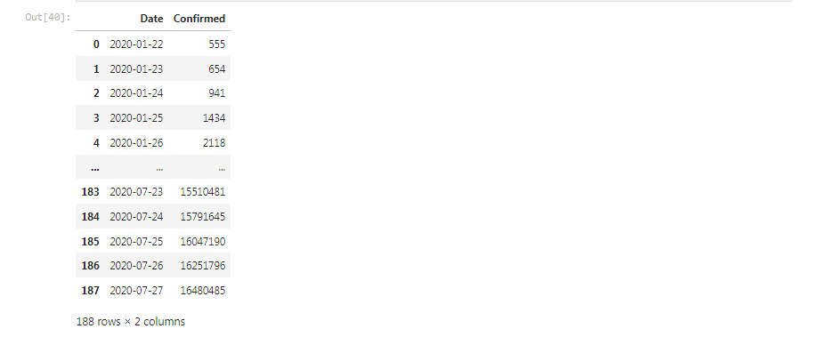

Slide 14
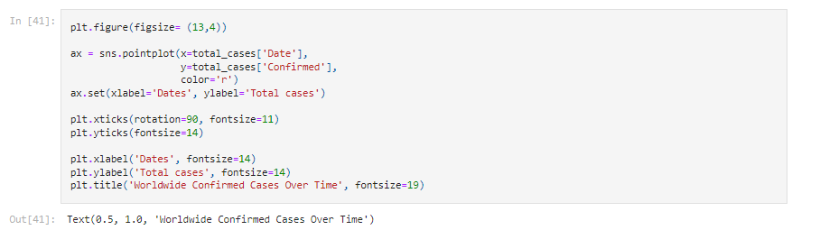

Slide 15
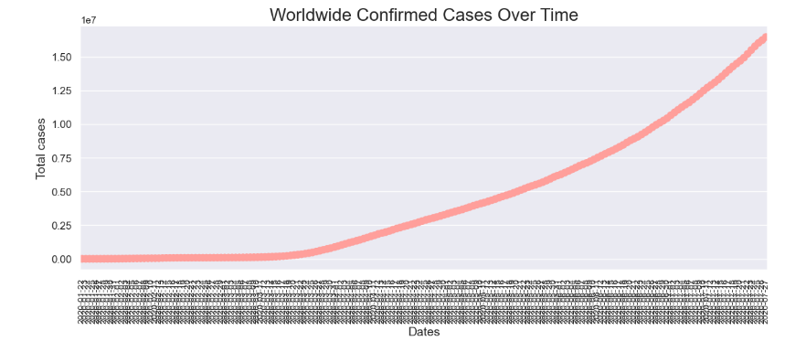

Slide 16
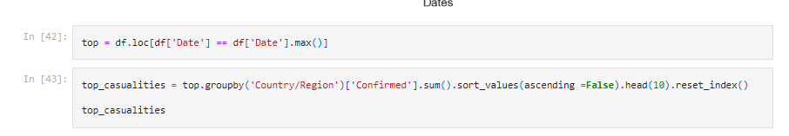

Slide 17
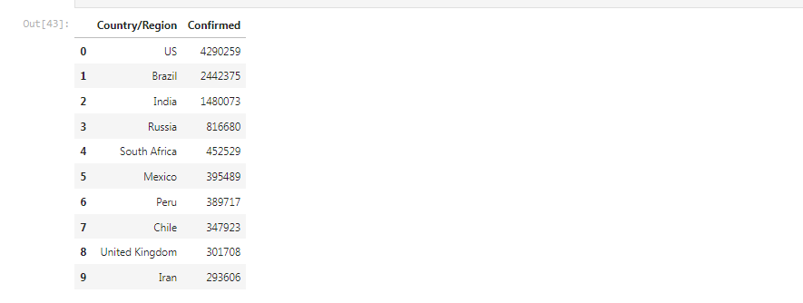

Slide 18
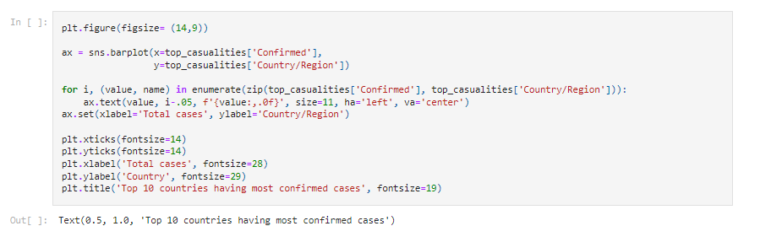

Slide 19
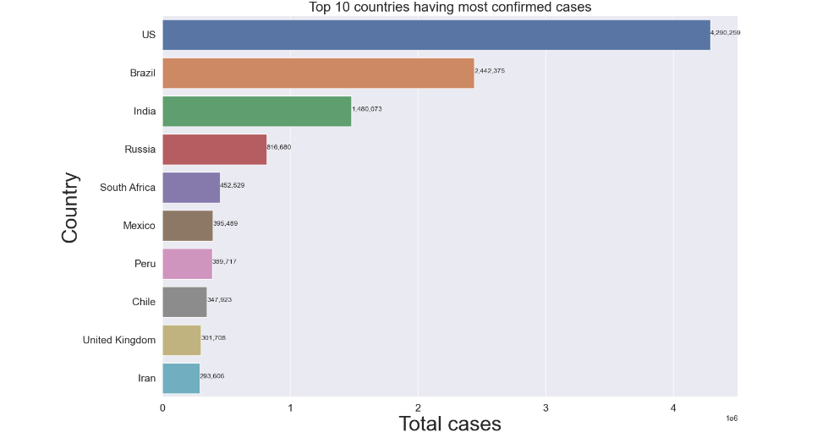

Slide 20
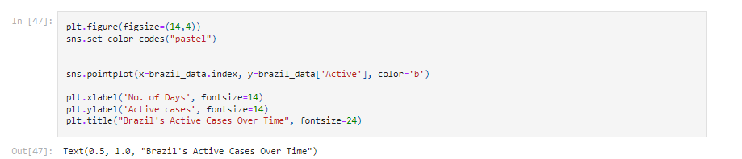

Slide 21
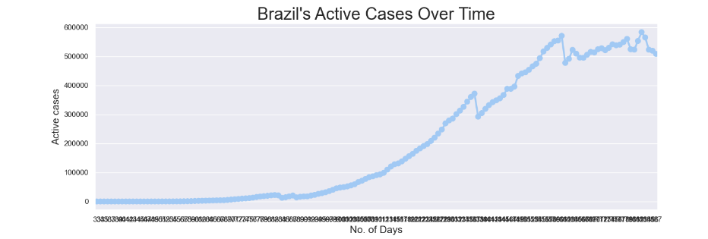

Slide 22
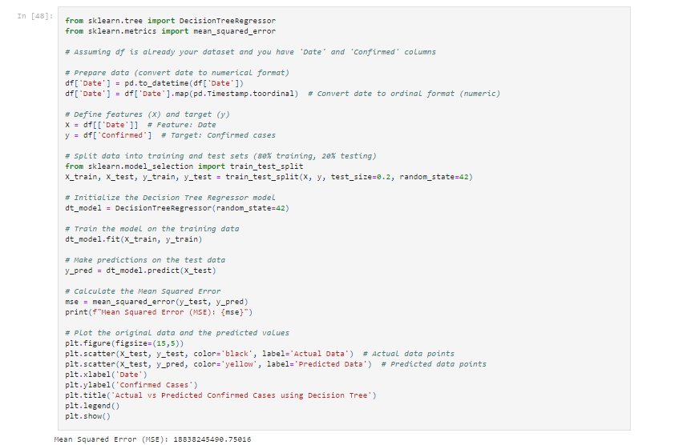

Slide 23
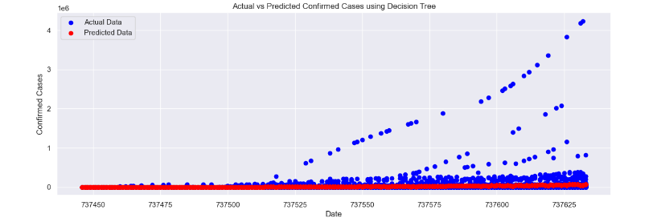

Slide 24
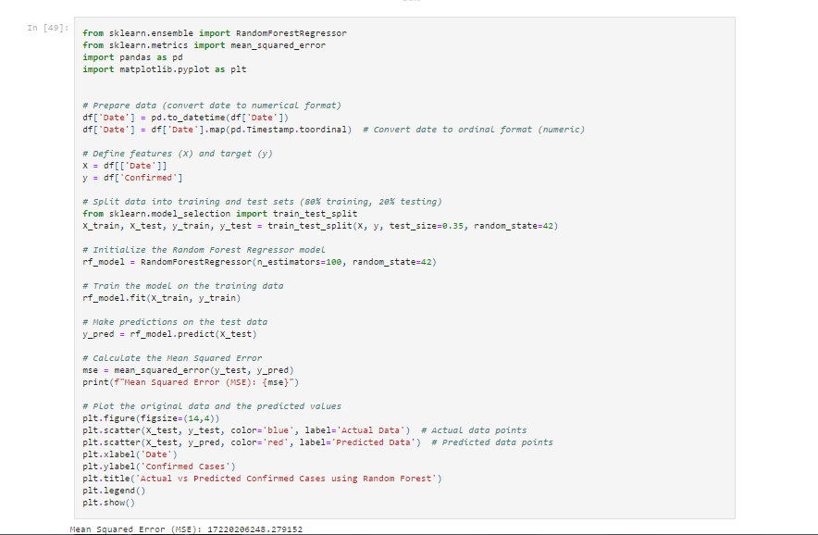

Slide 25
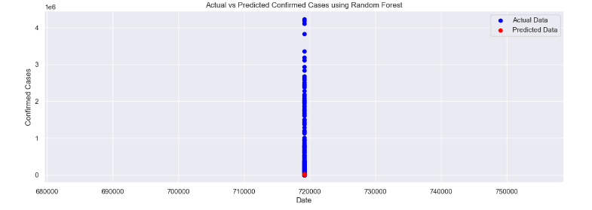

Slide 26
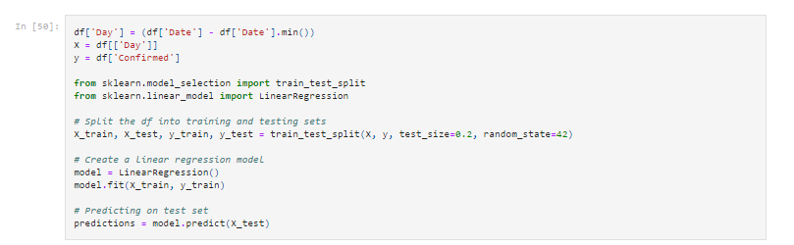

Slide 27
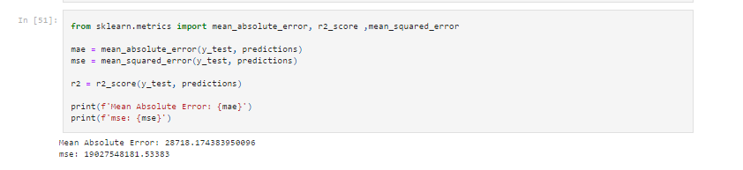

Slide 28
THANK YOU

